Slide 1
INVESTMENT ASSIGNMENT SUBMISSION
Name: SHRUTI SHARMA

Slide 2
Abstract The CEO of Spark Funds wants to understand the global trends so that they can take the investment decisions effectively and make investments in few companies
SPARK FUNDS: INVESTMENT ANALYSIS
Business understanding:
The overall strategy is to invest where most investors are investing with two minor restrictions for investments as listed below:
Spark funds wants to invest between 5-15 million USD per round of investment.
They want to invest only in English speaking countries.
Data Understanding and goals:
There are three goals for analysis as below:
Investment type analysis: Comparing the typical investment amounts in the venture, seed, angel, private equity etc. so that Spark Funds can choose the type that is best suited for their strategy.
Country analysis: Identifying the countries which have been the most heavily invested in the past.
Sector analysis: Understanding the distribution of investments across the eight main sectors

Slide 3
DATA ANALYSIS
Data Preparation
Load the two data files: 1.companies
2.rounds
Merge data, identify and treat (delete or impute)missing data, and format data
Cleaned master dataset for analysis is ready
START
Data Analysis using Python
Y
Y
Average investment between 5-15M USD per investment round
English speaking country?
Identify top 9 countries with highest investments
Data of selected funding type
Identify funding type
N
N
Top 3 English speaking
countries
Integrate data for top 3 countries and main sectors
Plot the graphs required
END

Slide 4
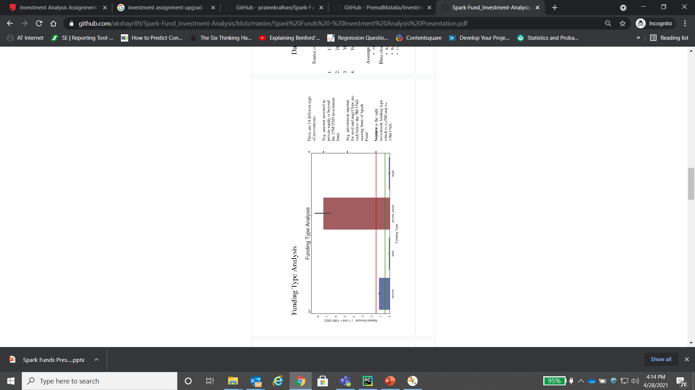
FUNDING TYPE ANALYSIS
Plot 1: A plot showing the representative amount of investment in each funding type.
KEY RESULTS
There are 14 different type of funding. Out of these, we are looking into 4 investments:-
1. Angel
2. Seed
3.Venture
4.Private equity
Avg investment amount for seed and angel type are below 5M USD stating the limit of Sparks Fund whereas private equity exceeds the limit of 15M USD, thus, all these 3 are out of scope
Venture is the only funding type between 5M USD – 15M USD.

Slide 5
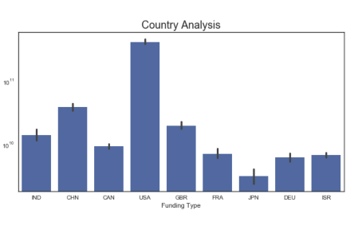
COUNTRY ANALYSIS
Plot 2: A plot showing the countries in each funding type.
KEY RESULTS
USA amounts as the most invested country with a total of 420B USD.
CHN (China) ranks second but is out of scope as its not an English-speaking country.
Thus, GBR (United Kingdom) and IND (India) along with USA grab the position of top 3 countries for investments

Slide 6
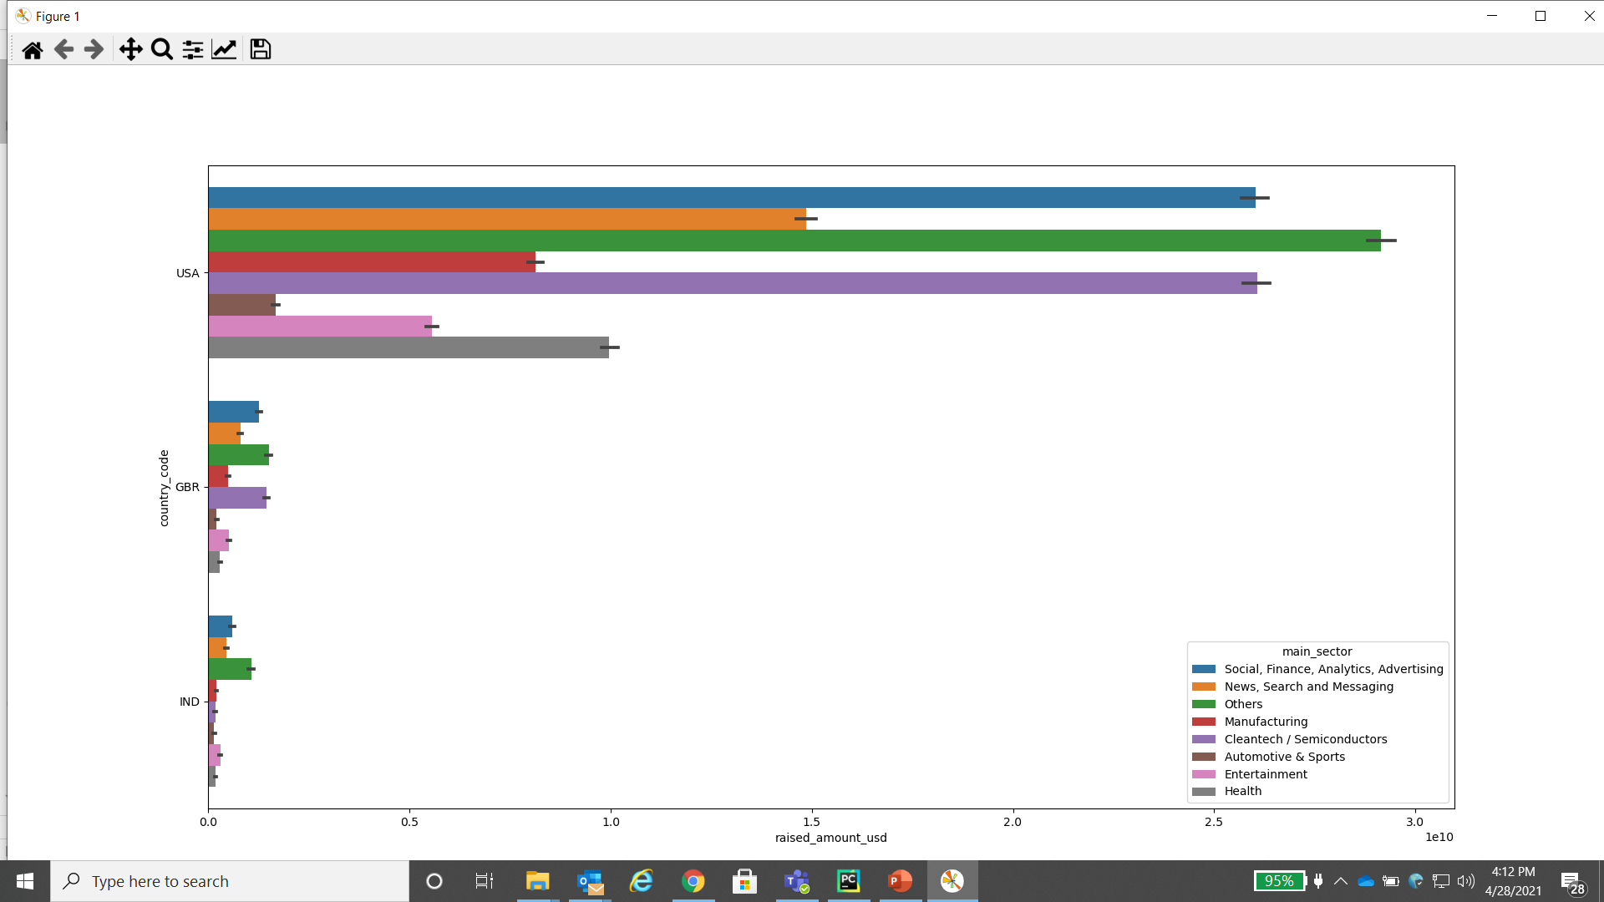
SECTOR ANALYSIS
Plot 3: Investment in top 3 countries across main sectors
KEY RESULTS
USA and GBR could invest in “Others”, “Social , Finance, Analytics , Advertising” and “Cleantech/semiconductors” as these are the top 3 sectors in these countries.
However, IND could invest in “Others”, “Social , Finance, Analytics , Advertising” and “News, Search and Messaging”

Slide 7
Below are details for investing across top 3 countries, top sectors and companies for investment in Venture funding type
Sparks Investment: Conclusions
KEY RESULTS
Spark Funds should consider investing in Venture funding type.
The most promising main sector across all countries is ‘Others’.
USA has most investments in the main sector ‘Others’ followed by ‘Social,Finance,Analytics,Advertising’ and ‘Cleantech/Semiconductors’ main sector.
Other than USA, GBR and IND are the countries to be invested in. This would reduce risk due to country specific economic fluctuations.
For USA,GBR and IND; ‘Emory-University’, ’IP-Access’ and ‘Firstcry-com’ are the best companies to invest in respectively.
Countries to invest --> | USA | GBR | IND
Main Sectors to invest in --> | Others | Others | Others
 | Social, Finance, Analytics, Advertising | Cleantech / Semiconductors | Social, Finance, Analytics, Advertising
 | Cleantech / Semiconductors | Social, Finance, Analytics, Advertising | News, Search and Messaging
Companies to invest in --> | EMORY-UNIVERSITY | IP-ACCESS | FIRSTCRY-COM
 | VIRTUSTREAM | ELECTRIC-CLOUD | MYNTRA

